Slide 1
Quantum Computing
Stanley Ngugi

Slide 2
Objectives
To understand the general working mechanism of a quantum computer.
To identify the potential problems that quantum computers can solve
To find out how to harness the power of a quantum computer.
To review the potential impact of quantum computers in cybersecurity
To review the challenges that hinder the construction of quantum computers.

Slide 3
Classical computers vs Quantum Computers
Classical computers store information as bits that each take a value of 0 or 1. Underlying those bits are transistors that act as switches; each can take a value of either 0 or 1 depending on whether the switch is on or off. At the most basic level, everything a computer does is just manipulating the values of those bits with small electrical voltages.
A quantum computer’s equivalent to a bit is known as a qubit which can either exist as both a 1 and 0 simultaneously. This makes it possible to perform multiple computations to happen simultaneously.
This special state of being simultaneously 0 and 1 is known as superposition and allows large amounts of information to be represented using a few quantum particles. Qubits can be linked together to form a series of qubits which can represent different things simultaneously.

Slide 4
Quantum Mechanics
Quantum mechanics is a branch of science that deals with the behaviour of matter and light on the atomic and subatomic scale. It attempts to describe and account for the properties of molecules and atoms. These properties include the interactions of the particles with one another and with electromagnetic radiation
Quantum theory predicts that particles may be one thing or another at the same time. This forms the basis of quantum mechanic.

Slide 5
Brief History
Feyman's idea - A physicist in 1980 tried to simulate quantum events but he realized that classical computers could not handle quantum computations due to the high cost of computation. He therefore made a tool composed of quantum particles to simulate the events and the idea of quantum computing was born.

Slide 6
What complex problems can a quantum computer solve
In situations where there are a large number of possible combinations, quantum computers can consider all of them simultaneously.
Such cases include:
When trying to find the best route between two places.
Optimization Problems
Simulating any quantum physical system
Searching in unordered lists

Slide 7
Application Areas
Weather and climate modeling
Personalized medicine
Space exploration
Encryption

Slide 8
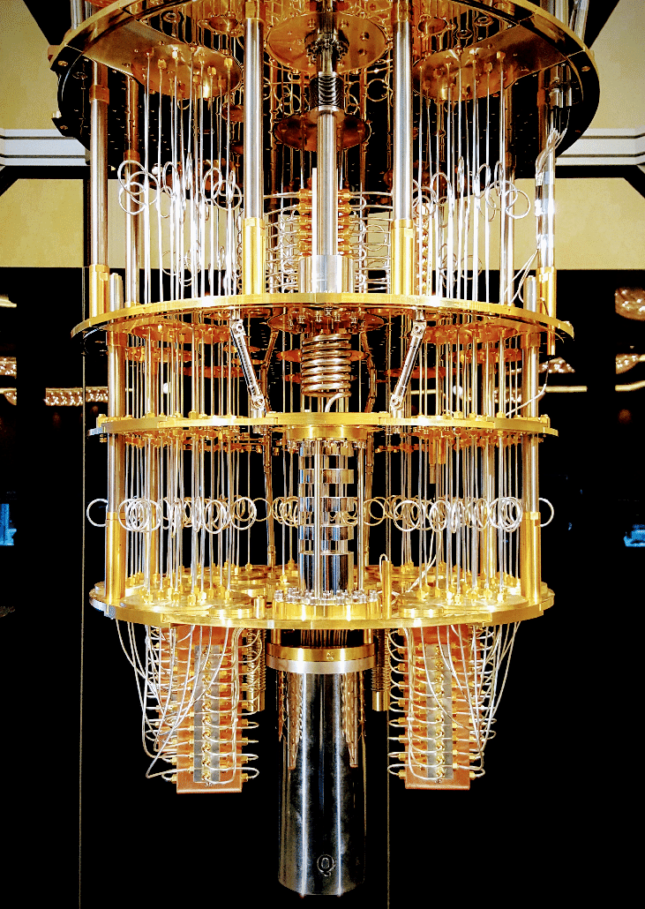
Q
The Steampunk Chandelier

Slide 9
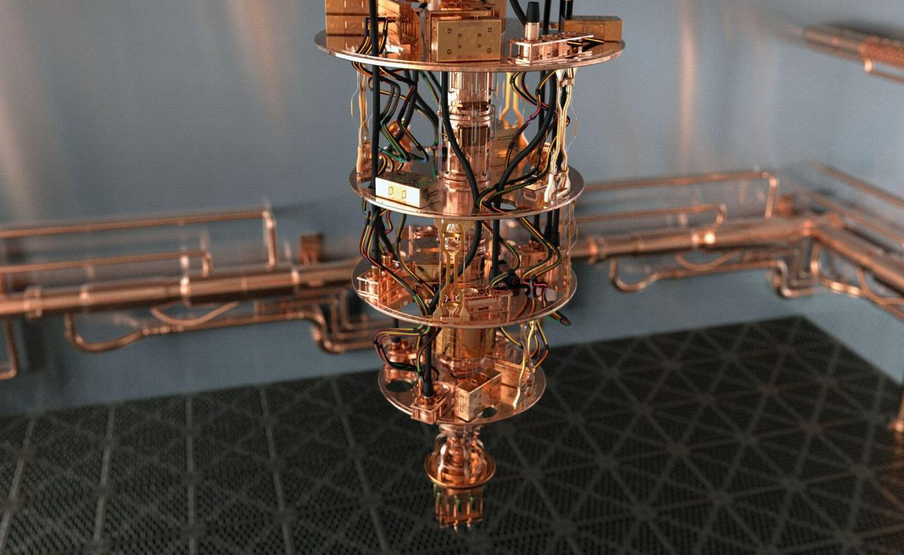

Slide 10
The End!

